Slide 1
JAVA BEANS

Slide 2
What is a Java Bean?
“ A Java Bean is a reusable software component that can be visually manipulated in builder tools.”

Slide 3
JavaBeans
JavaBeans is a component model for Java.
It defines Java components and how they fit together.
Allows users to construct applications by joining components together either programmatically or visually
Visual programming is a key part of the component model.

Slide 4
JavaBeans Architecture
Architecture supports the features of software reuse, component models and object orientation.
Compact and Easy
Portable
Flexible Build-Time Component Editor
Persistence
Support of Visual Programming

Slide 5
SAMPLE public class MyBean implements java.io.Serializable
{ protected int theValue; public MyBean()
{
} public void setMyValue(int newValue) { theValue = newValue;
} public int getMyValue()
{ return theValue;
}
}

Slide 6
Key Technologies
Events
Introspection
Customization
Persistence
Distributed Systems

Slide 7
Events
Events are messages sent from one object to another notifying the recipient that something has happened
Register Event Listener
fire events
Fire Event
Event Source
Event Object
Event Listener

Slide 8
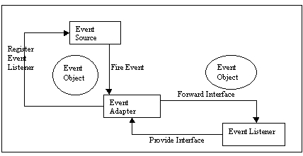
Event Adapters

Slide 9
Introspection:
  Is a process of exposing the properties, methods and events that a JavaBean component supports.
  Enables a builder tool to analyze how a bean works.
  This process is used at run-time as well as by a visual development tool at design time

Slide 10
Customization:
  Enables the developer of a Bean component to customize the appearance and behavior of a bean
  A custom property editor should to be created to associate with the custom classes
Properties:
  Supports the customization mentioned above.

Slide 11
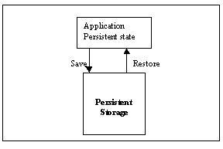
Persistence
Enables developers to customize Beans and then retrieve those Beans later, with customized features intact

Slide 12
Create a JavaBean
  Create a Bean(jar) file
jar cfm FancyButton.jar\
FancyButton.mf FancyButton.class FancyButton.gif FancyButton.au
Copy the Bean file to C:\BDK1.0\jars
Test the Bean in the BeanBox.

Slide 13
The jar command syntax is:
Jar[ctxvfm][jar-file][manifest-file]files…
  Option flags are:
c : create new archive
t : list table of contents for archive
x : extract named(or all) files from archive
v : generate verbose output on standard error
f : specify JAR file name
m : include manifest information from specified manifest file

Slide 14
Bean Box
Bean Box is a sample bean that’s comes in the kit ( BDK).It allows you to test the functionality of your beans, including properties, events and serialization.
Bean Box allows you to
  drop beans onto a composition window
  resize and move beans around
  edit the exported properties of a bean
  run a customizer to configure a bean

Slide 15
  connect a bean event source to an event handler method connect together bound properties on different beans
  save and restore sets of beans
  get an introspection report on a bean
  add new beans from JAR files

Slide 16
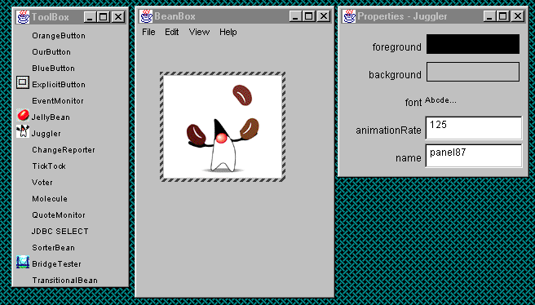
BeanBox Tool

Slide 17
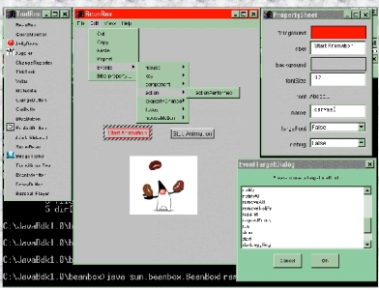

Slide 18
Summary
    “Java is the only ubiquitous platform for the global Internet of tomorrow.”
Java Beans is the best component technology for the Internet based computing.
    “Write once and reuse “
Beans are “first class” COM components

Slide 19
References
Developing Java Beans by Robert Englander-O’Reilly publications
http://sun.java.javabeans
http://library.thinkquest.org/11537/javabean.html
http://java.sun.com/products/javabeans/devcon/sld001.htm
http://jliusun.bradley.edu/~jiangbo/javaroom/Beans12/sld005.htm
http://www.cbdedge.com/cbdweb/CBDTutorial/sld105.htm

